Slide 1
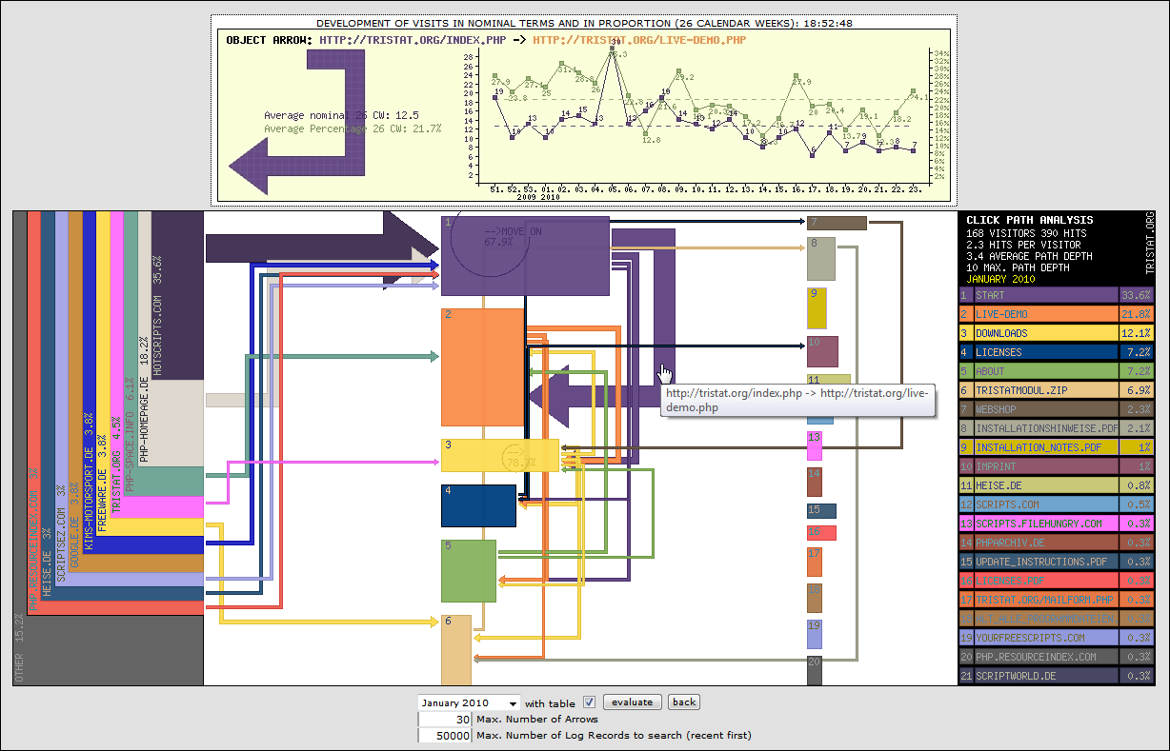
Web Analytics
Web Analytics

Slide 2
Web analytics
…….. is the study of the behaviour of website visitors. It refers to the use of data collected from a web site to determine which aspects of the website work towards the business objectives; for example, which landing pages encourage people to make a purchase.

Slide 3
Definition
Web analytics is the objective tracking, collection, measurement, reporting and analysis of quantitative internet data to optimize web sites and web marketing initiatives
www.webanalyticsassociation.org

Slide 4
Demystifying Web Analytics
Basics
Understand the Traffic Sources
Reduce Bounce Rate
Focus on Outcomes

Slide 5
Basics
Visits
Page Views
Avr. Time on Site
Bounce
% of New visits
Notes:
What is it?
Visits represents the number of sessions on your website, number of times someone interacted with your site. Bounce is the number of those who left instantly!
The Page Views number is how many pages were requested in those visits. Oh and how many in each visit, Pages / Visit.
Avg Time on Site, how long did people stay on your site.
% New Visits shows how many sessions, interactions, were from people (yes people!) who visited your site for the first time.

Slide 6
Traffic Sources
Direct Traffic
Referring Sites
Search Engines
Other
Notes:
What is it?
Direct traffic are all those people showing up to your website by typing in the URL of your website or from a bookmark. Some people also call this “default traffic” or “ambient traffic”.
Sometimes you’ll see “non direct” traffic in the direct bucket. From badly coded redirects (remember to make all redirects Permanent) or even improperly coded campaigns. Now you know why that is important.
Referring URL’s are other websites sending traffic to you. These could be as a result of your banner ad’s or campaigns. These could be all those blogs or affiliates who link to you.
Search engines, well that’s you know who. Google, Yahoo, MSN, Ask, others. This bucket will include both your Organic as well as you Paid (PPC ) traffic, so be aware of that.
Finally there is Other. These include campaigns you have run (and then have configured your tool correctly). Email, direct marketing, etc.

Slide 7
Reduce Bounce Rate
You are looking, first, for pages with the highest bounce rate i.e., single page view sessions.
Pages with a high bounce rate are not delivering on the promise that is driving customers to your site.
Notes:
We’ll do two things here, we’ll look at a report in your web analytics tool that shows the Bounce Rate for the Top Entry Pages.
What is it?
As you perhaps already realize you have lost control of what the home page of your website is. Search engines decide what the home page of your website is. People search for you (or click through from a link on another site) and go directly deep into your site.
The top entry pages report, first one up there, shows you how many people are entering on each page of your website, and hence they show the top “home pages” of your website. Super!
By adding the bounce rate (in case you don’t know what it is please read: Standard Metrics Revisited: Bounce Rate) you have a indicator of how engaging :) each of your “home pages” are.
Ditto for the keyword report. Search is where all the traffic is, for now.
What is it telling you?
Simple: Stinkiness. Your site’s.
You are looking, first, for pages with the highest bounce rate. Remember bounce rate measures this from a costumer’s perspective: I came, I did not like it! I left . Or technically speaking: single page view sessions.
Pages with a high bounce rate are not delivering on the promise that is driving customers to your site. The ones in the top ten Entry Pages report need your attention.

Slide 8
Reduce Bounce Rate
You are looking, first, for pages with the highest bounce rate i.e., single page view sessions.
Pages with a high bounce rate are not delivering on the promise that is driving customers to your site.
Track this metric, make changes to the page, and look for trends. You want this metric to fall over time as you tweak design, navigation, links.
Notes:
We’ll do two things here, we’ll look at a report in your web analytics tool that shows the Bounce Rate for the Top Entry Pages.
What is it?
As you perhaps already realize you have lost control of what the home page of your website is. Search engines decide what the home page of your website is. People search for you (or click through from a link on another site) and go directly deep into your site.
The top entry pages report, first one up there, shows you how many people are entering on each page of your website, and hence they show the top “home pages” of your website. Super!
By adding the bounce rate (in case you don’t know what it is please read: Standard Metrics Revisited: Bounce Rate) you have a indicator of how engaging :) each of your “home pages” are.
Ditto for the keyword report. Search is where all the traffic is, for now.
What is it telling you?
Simple: Stinkiness. Your site’s.
You are looking, first, for pages with the highest bounce rate. Remember bounce rate measures this from a costumer’s perspective: I came, I did not like it! I left . Or technically speaking: single page view sessions.
Pages with a high bounce rate are not delivering on the promise that is driving customers to your site. The ones in the top ten Entry Pages report need your attention.

Slide 9
Focus on Outcomes
Identify two or three metrics that identify outcomes
Notes:
What is it?
e.g., for a blog it is the number of people who visit the speaking engagements page, and go attend one of the engagements.
For a non-profit it is also looking at number of people using the core search functionality (to look for stuff like jobs).
For a ecommerce website it is the bottomline numbers. Revenue, conversions, average order value, products sold etc etc.
What is it telling you?
Visitors are coming to the website, but is it having any impact on you.
If there is a impact on your bottom line. Are you converting enough? Not as much?
What’s selling and what is not? Why is it selling? How much of it?
All web analytics tools have a capability to help you understand outcomes. Omniture, WebTrends, CoreMetrics, VisualSciences, Google Analytics or whatever else you have. Get the above stuff.

Slide 10
Metrics
What would be meaningful for a site selling products?

Slide 11
Metrics
What would be meaningful for a site selling products? - sales per visit?

Slide 12
Key Metrics
Key metrics are usually a ratio of something measuring an "action" to visits or visitors.

Slide 13
Key Metrics Examples
What % of visits signed up for the newsletter?
What % of visits lasted were > 20 mins?
What % of visits viewed > 10 pages?

Slide 14
Know what you are measuring
E.g., if you want to study sales per visit, do you want to include visits from spiders and robots
If you include these visits, you artificially decrease your sales per visit.

Slide 15
Break into Segments
So then we starting the maximize process - instead of looking at the whole site, break into different segments.
Sales per visit by search engine,
Sales by pay-per-click ads
Some products on the home page produced higher sales per visit than others. And so on.

Slide 16
Know what you are measuring
Use data from the same time period for each part of the metric - a day, a week, a month.
Otherwise comparing them and looking for trends does not work.

Slide 17
Get Continuous
How do you use metrics? Measure, manage, maximize. First you measure & track to see where you are.
Then you try to manage the metric by making changes to the site - when you make changes, did the metric get better or worse?

Slide 18

Have a fast, functional, mobile-friendly website
There are 8.3 billion people on the planet and 7.2 billion subscriptions.
What's your excuse for not spending a few dollars making your site mobile-friendly?

Slide 19
Heat Map
shows which links visitors click the most
It is the cluster of clicks on a web page and their density by using colours – the brighter the colour, the more clicks

Slide 20

Clickstream
Insights

Slide 21

Your Audience is not a Monolith

Slide 22
Why come to Site?
Examples:
?

Slide 23
Why come to Site?
Examples:
Purchase a Product
Product or Service Support
Register my Product
Check Order Status

Slide 24
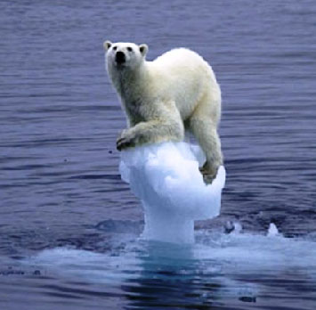
You are not Alone

Slide 25
You are not Alone
Competitor Intelligence

Slide 26
Avinash Kaushik, Digital Marketing Evangelist – Google
Video
https://www.youtube.com/watch?v=_s-9mIQyJto
http://www.kaushik.net/avinash/

Slide 27
"Look, it is insanely cheap to fail on the web. It takes little money – comparatively – to try a new advertising medium, or improve your website, or build a mobile app, or try just about anything else.
So why look at what the 'benchmarks' say? Let's take a tiny portion of the budget, try things live, learn for our business, and win over time.“
Avinash Kaushik

Slide 28
Avinash Kaushik
“we tend to be logical, and we often treat data output as the end when in reality the data output is just the start of the process that results in actions that deliver business impact.”
Notes:
Avanish …”I was speaking with a massive national insurance company recently. To implement a couple of my ideas they shared that it would take them seven months to update the code on their website. Obviously this is a multi-billion dollar corporation, some rigidity and layers are to be expected. But., Seven months! I was not even asking for something crazy like moving from old lamer tags to a full featured Universal Analytics implementation. They already have bits of the latter, I'd recommended a couple simple upgrades.
No matter how good your idea, if you can't get it implemented quickly, it is dead on arrival. Yes, you can blame the IT team and their long queue of things and prioritization process. DOA.”

Slide 29
Digital Marketing & Measurement Model.
“If you don't know where you are going, any road will take you there and you'll be miserable when you arrive.” Avanish
Objectives | Goals | KPIs | Targets | Segments.
Notes:
know the strategic priorities of the business
Q1. Why does your digital presence exist? [You plus the most senior CxO who will talk to you.]
Q2. What specific strategies are you currently leveraging to accomplish aforementioned objectives? [For most of us, you plus the CMO/equivalent.]
Q3. What one critical metric will help you clearly measure performance for each strategy above? [You.]
Q4. How will you know if the performance was a success or failure, what's the target for each critical metric? [You plus Finance plus CMO.]
Q5. What group of people, their sources, digital behavior, and outcomes are most important for business success? [You plus Marketing Team.]

Slide 30
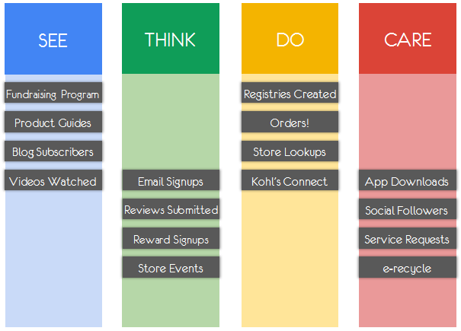
Kohl’s Analytics
Notes:
Thinking strategically and solving for all clusters of digital intent? Online, offline, mobile, acquisition, brand love, relationships, product pimping, community stewardship and so much more!

Slide 31
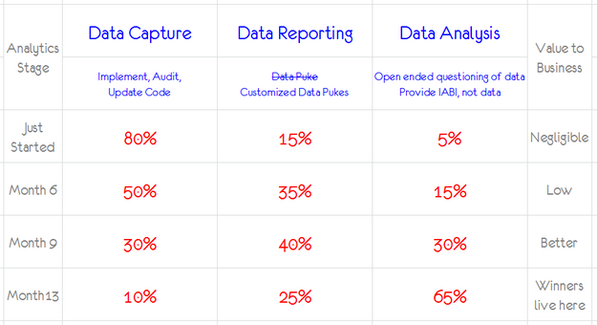

Slide 32
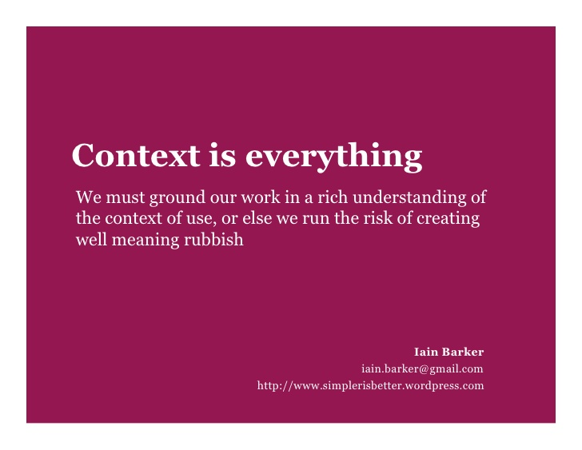
Context

Slide 33

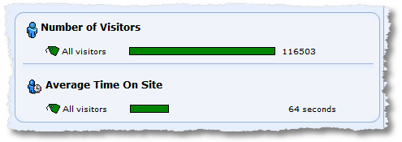
What can you infer from this?
Almost nothing

Slide 34
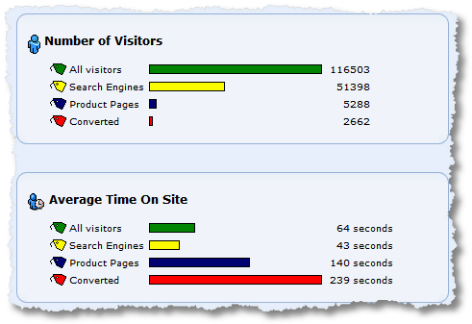
Notes:
For your 116,503 Visitors you know some interesting things: Approximately half came from search engines, only a tiny fraction, 5,288, did what you wanted them to, look at product pages, and, perhaps more humblingly, a tiny tiny fraction converted.
From the second set of data for Average Time On Site you get a sense for the varied distributions in time each segment spends on your site. 64 seconds might have felt like a hurtfully low number for your beautiful engaging site. Now you know that at least some people spend more time on the site (those that make it to product pages). You also know how long it takes for someone to convert, 239 seconds.
Picture t raises the right questions that need being asked.
It will also help focus the initial analysis effort that you'll undertake. You'll ask why 51,398 Visitors to your site spent 43 seconds on average on your site. Where do they enter, what keywords, paid per click or organic? What can we fix? is 239 seconds the right amount of time to conversion?
Avinash

Slide 35
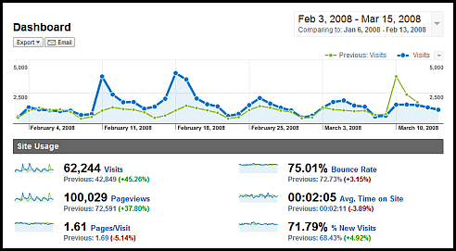
Compare trends over different time periods.

Slide 36
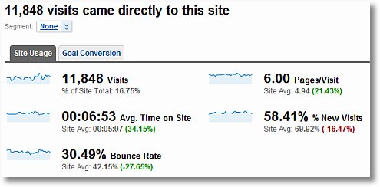
Compare trends over different time periods.

Slide 37
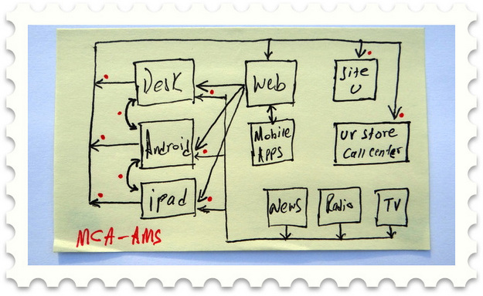
Multi-Channel Attribution
The primary challenge is that as we switch devices it is increasingly difficult to keep track of the same person as they interface with our digital existence

Slide 38
FB and Analytics Example
Here's a summary of a FB case study
1. Client posted a video of a soon to be released product on their Facebook brand page.
2. That video got a large no. of Likes.
3. Client also runs Facebook Promoted Ads for that post. Gets more Likes.
4. ROI? Assume – huge. It was huge. New product became the number one selling product in the company's history
5. Facebook works.
http://www.kaushik.net/avinash/facebook-advertising-marketing-best-metrics-roi-business-value/

Slide 39
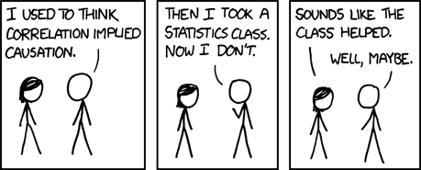
Correlation
Conclusion implies a causality that may or may not be there ("the product sales exceeded all internal projections!").
http://www.kaushik.net/avinash/facebook-advertising-marketing-best-metrics-roi-business-value/

Slide 40
Correlations don't imply causality
Completely ignore the question of whether Facebook works. Focus on the fact that this was the launch of a powerful new product via a continent-wide rebranding campaign using massive online and offline media buys.
A push on Facebook was a part of that effort.
So to imply the ROI in Step 4 is sub-optimal.
From the data presented, there is no way to tell if the Facebook campaign worked or not. Even if there were millions of Likes

Slide 41
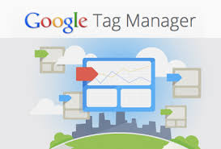
Google Tag Manager
This is a free tool that makes it easy for marketers to add and update website tags -- including conversion tracking, site analytics, remarketing…just a few clicks, & without needing to edit your website code.
https://support.google.com/tagmanager/answer/6102821?hl=en
Notes:
one click deploy valuable things like exit-link, downloads, scroll tracking etc
If your company does not have a Tag Manager and its supporting processes deployed, you are simply not serious about wanting to make speedy smart business decisions. The size of your business is irrelevant. End of story.

Slide 42
Tag Manager
Tags are snippets of code on your site that collects data (Google Ads conversion tracking, Google Analytics), target your ad campaigns

Slide 43
Tag Manager
Tags are snippets of code on your site that collects data (Google Ads conversion tracking, Google Analytics), target your ad campaigns (Google Ads remarketing) track ads (Double Click) and perform other functions.
Instead of editing or adding tags to site pages each time you want to change or add functionality, you can let Google Tag Manager do it for you.

Slide 44
Digital Marketing Tips
Spend 15% of your Marketing budget, every month, on experimenting with new techniques / channels / ideas.

Slide 45
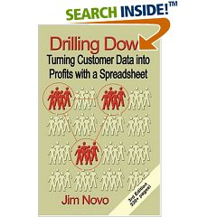
www.jimnovo.com

Slide 46
Customer Promotion Tips
1. If you want buyers, advertise where people buy.
2. Behaviour of customers from search engines & banner ads is different
3. 50%-60% will be one-time buyers/visitors. Accept it.
4. The only chance you have at getting a first-time buyer to purchase again is to contact them quickly after the first purchase.
www.jimnovo.com
Notes:
1. If you want buyers, advertise where people buy.
2. Customers from search engines will have different buying patterns than customers from banner ads. Measure differences.
3. 50-60 percent will be one-time buyers/visitors. Accept it. You'll waste a ton of money trying to change it, and it's not going to change. One-time buyers who bought multiple items on the first purchase are a possible exception. Try them first. Then try one-time buyers with the highest order value. If these don't bite, none of the one-time buyers will.
4. The only chance you have at getting a first-time buyer to purchase again is to contact them quickly after the first purchase.

Slide 47
Customer Promotion Tips
5. One-time buyers who return their only purchase CAN be better marketing targets than those who don't return their purchase
6. Resend a promotion to the same people. You can often get 50% of the first response rate if the original promotion was a targeted one.
www.jimnovo.com
Notes:
5. One-time buyers who return their only purchase CAN be better marketing targets than those who don't return their purchase - IF the customer service experience they have in dealing with the return is outstanding.
6. Customers on average will buy down in price over their LifeCycle; - buyers who "go cheap" on the first purchase usually have lousy future value.
7. One $50 1st purchase customer is worth more than two $25 1st purchase customers.
8. Resend a promotion to the same people. You can often get 50% of the first response rate if the original promotion was a targeted one. It's OK to send exactly the same promotion, can be better to send slightly different copy, like "2nd chance!“

Slide 48
Customer Behaviour
Retention Marketing requires allocating marketing resources. Some marketing activities & customers will generate higher profits than others.
It means when you have a choice - instead of spending the same amount of money on every customer, you spend more on some and less on others.
If you allocate marketing $ towards higher ROI efforts, profits will grow even as the marketing budget stays flat.
You have to develop a way to allocate resources to the most profitable promotions, deliver them to the right customer at the right time
Notes:
4. Retention Marketing requires allocating marketing resources. You have to realize some marketing activities and customers will generate higher profits than others. You can keep your budget flat or shrink it while increasing sales and profits if you continuously allocate more of the budget to highly profitable activities and away from lower profit activities. This doesn't mean you should "get rid" of some customers or treat them poorly.
It means when you have a choice, as you frequently do in marketing, instead of spending the same amount of money on every customer, you spend more on some and less on others. It takes money to make money. Unless you get a huge increase in your budget, where will the money come from?
For example, let's say you have 1,000 customers, and you have an annual budget of $1,000. You spend $1 on each customer each year, and for that $1, you get back $1.10 in profits. That's an ROI of 10%; you got back $1,100 for spending $1,000.
Now, what if you knew spending $2 each year on a certain 50% of customers would bring back $8 in profits. That's a 400% ROI. Where do you get the extra $1? You take it away from the other 50% of customers. You spend the same $1,000 total and you make back 500 (half the customers) x $8 = $4,000.
If you always migrate and reallocate marketing dollars towards higher ROI efforts, profits will grow even as the marketing budget stays flat.
You have to develop a way to allocate resources to the most profitable promotions, deliver them to the right customer at the right time, and not waste time and money on unprofitable customers. This is accomplished by using the data customers create through their interactions with you to build simple models or rules to follow. These models are your listening system, like the "30 day latency" model . They allow the data to speak to you about the customer

Slide 49
Past and Current Customer Behaviour
Past and Current customer behavior is the best predictor of Future customer behavior.

Slide 50
Past and Current Customer Behaviour
Active customers are happy (retained) customers; and they like to "win."
Promotions encourage interaction of customers
Retention Marketing is:
Action – Reaction – Feedback – Repeat.
Marketing is a conversation & you have to LISTEN to what the customer is saying to you.
Notes:
2. Active customers are happy (retained) customers; and they like to "win." They like to feel they are in control and smart about choices they make, and they like to feel good about their behavior. Marketers take advantage of this by offering promotions of various kinds to get consumers to engage in a behavior and feel good about doing it. These promotions range from discounts and sweepstakes to loyalty programs and higher concept approaches such as thank-you notes and birthday cards. Promotions encourage behavior. If you want your customers to do something, you have to do something for them, and if it’s something that makes them feel good (like they are winning the consumer game) then they’re more likely to do it.
Retaining customers means keeping them active with you. If you don't, they will slip away and eventually no longer be customers. Promotions encourage this interaction of customers with your company, even if you are just sending out a newsletter or birthday card.
The truth is, almost all customers will leave you eventually. The trick is to keep them active and happy as long as possible, and to make money doing it.
3. Retention Marketing is all about: Action – Reaction – Feedback – Repeat. Marketing is a conversation. Marketing with customer data is a highly evolved and valuable conversation, but it has to be back and forth between the marketer and the customer, and you have to LISTEN to what the customer is saying to you.

Slide 51

Example Ryanair
In 2014 created Ryanair Labs – 20 Euro million/year investment
Decided to bring process of redeveloping Ryanair’s technology in-house
250 IT staff employed
Rebuild website
Developed a way of processing up to 300,000 bookings day
Average booking time halved from 3min 47 sec to 1min 54 sec
Source: Irish Times, 22 September 2018, https://www.irishtimes.com/culture/books/inside-ryanair-michael-o-leary-s-making-of-a-nicer-airline-1.3634667

Slide 52
Example Ryanair
Example Ryanair
Example Ryanair
“The opportunity for ancillary revenue though mobile are enormous.” (Hurley, CTO, Ryanair)”
All Ryanair customers would automatically become members
Cabin crew given hand held android devices, which would provide data on stock control, and would have customer’s preferences on board
“We see Ryanair becoming a kind of digital supermarket for everything that you need for travel.”

Slide 53
Example Ryanair
Example Ryanair and AWS
https://aws.amazon.com/solutions/case-studies/innovators/ryanair/
We built our employee app on Amazon Bedrock, and it’s been hugely successful for Ryanair and our growth.” CEO Ryanair

